Slide 1


SPECFEM++ Tutorial
CIG Meeting, Breckenridge, 2025
Rohit Kakodkar, Congyue Cui & Lucas Sawade
Research Computing/Geosciences Department

Slide 2
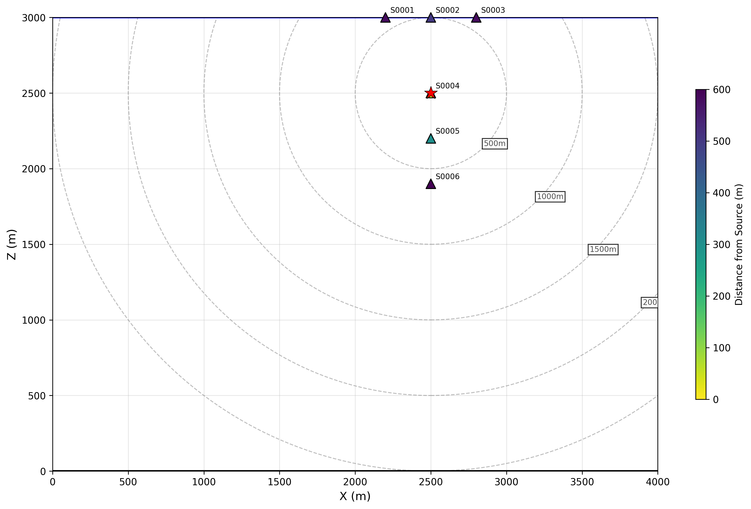
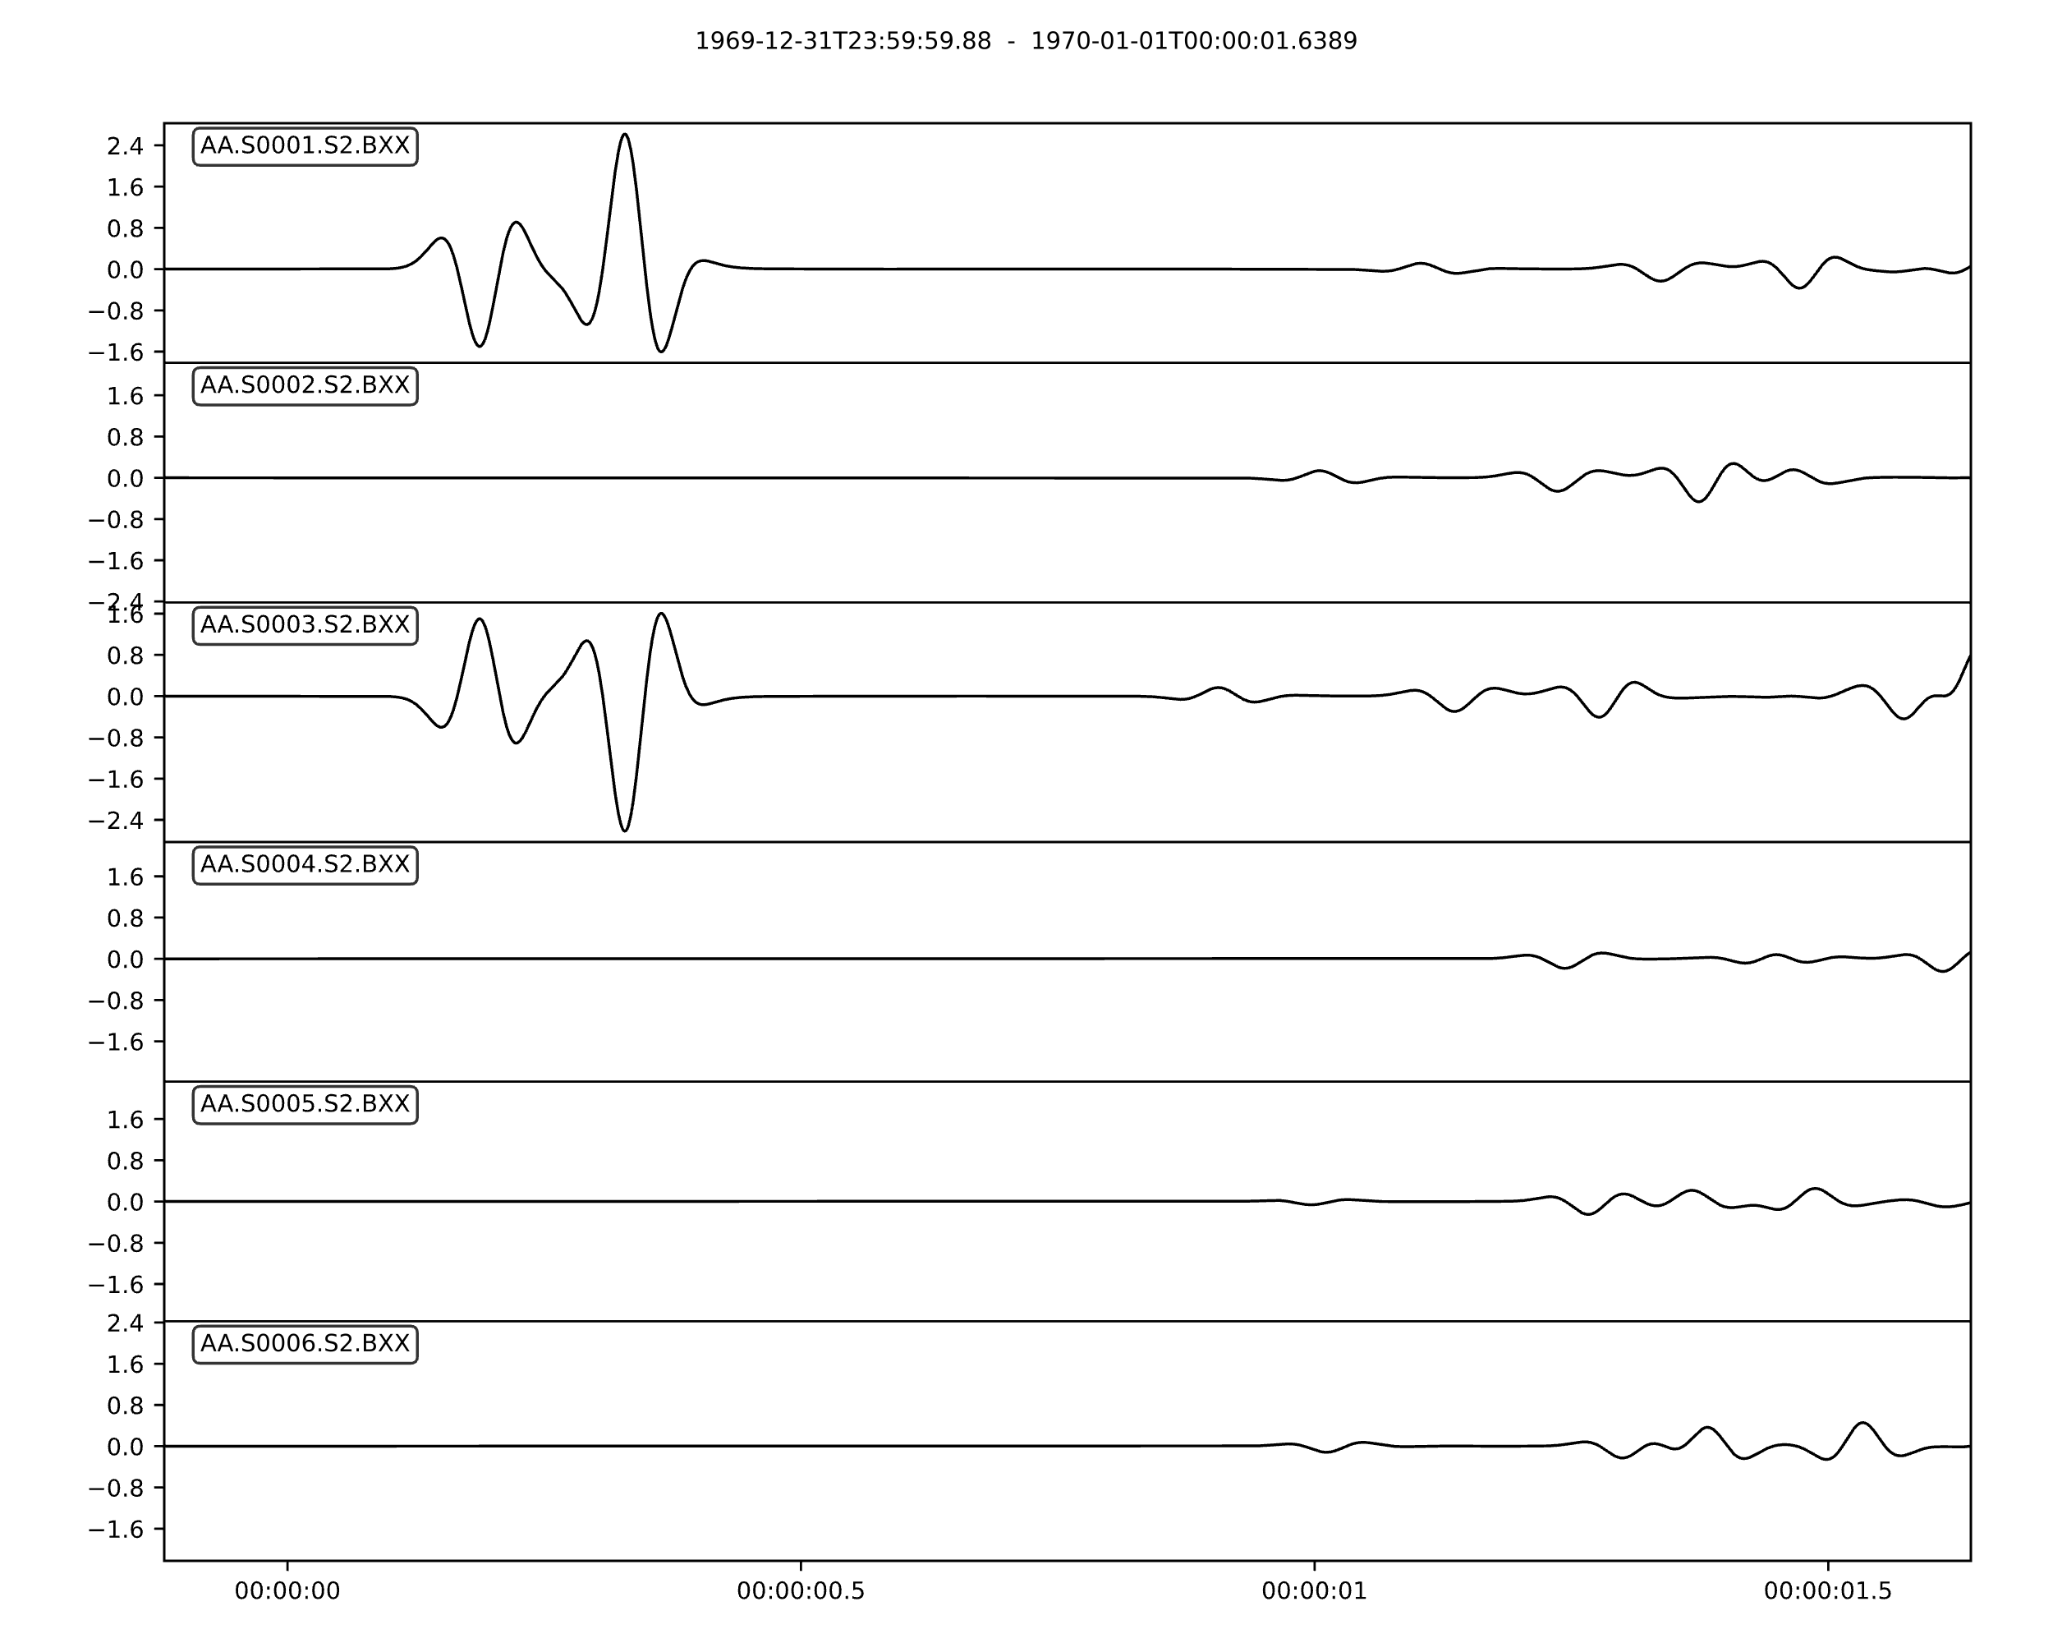
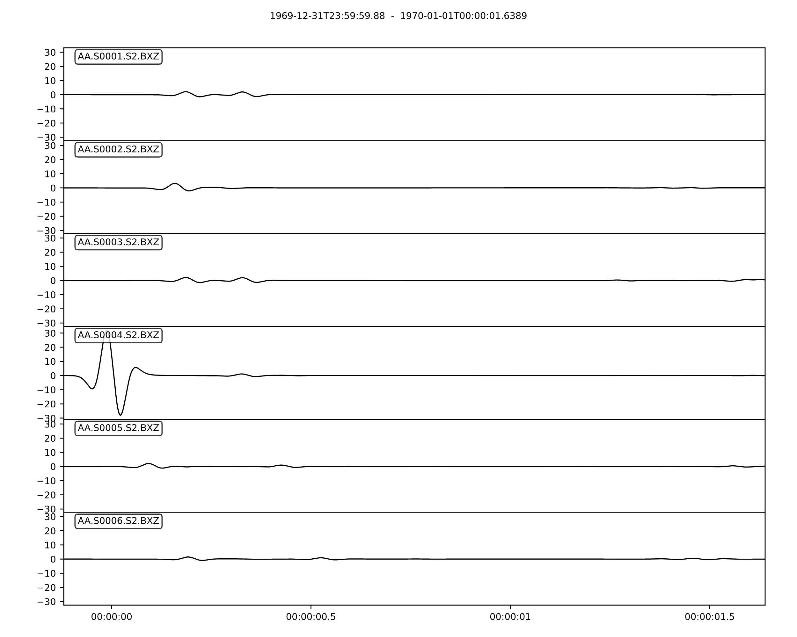

Homogeneous Elastic Example
u_{x}
u_{z}
1
2
3
4
5
6

Slide 3
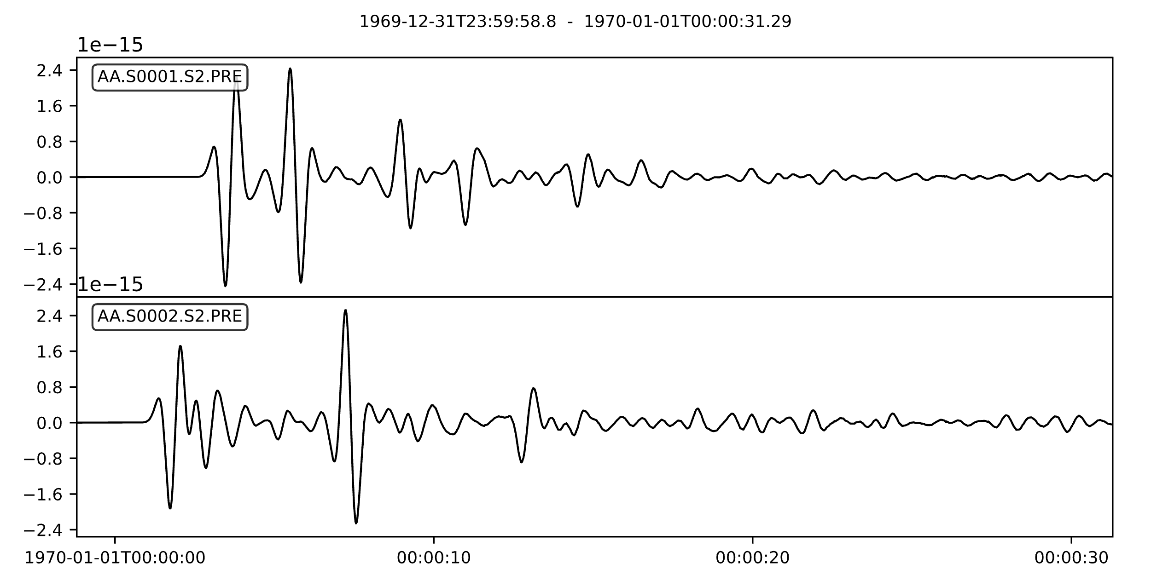
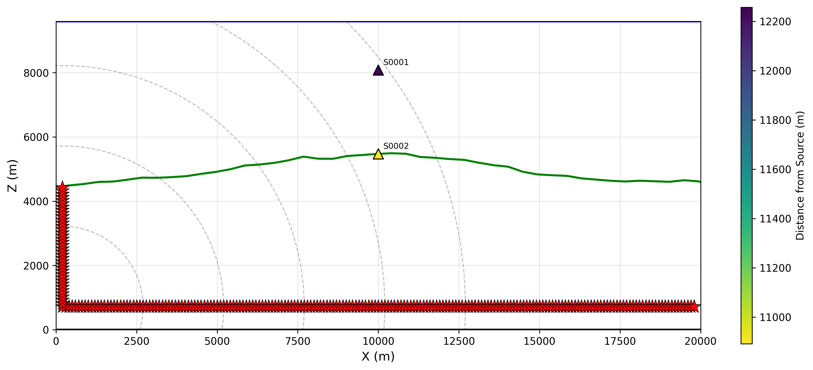

Fluid-Solid Bathymetry

Slide 4
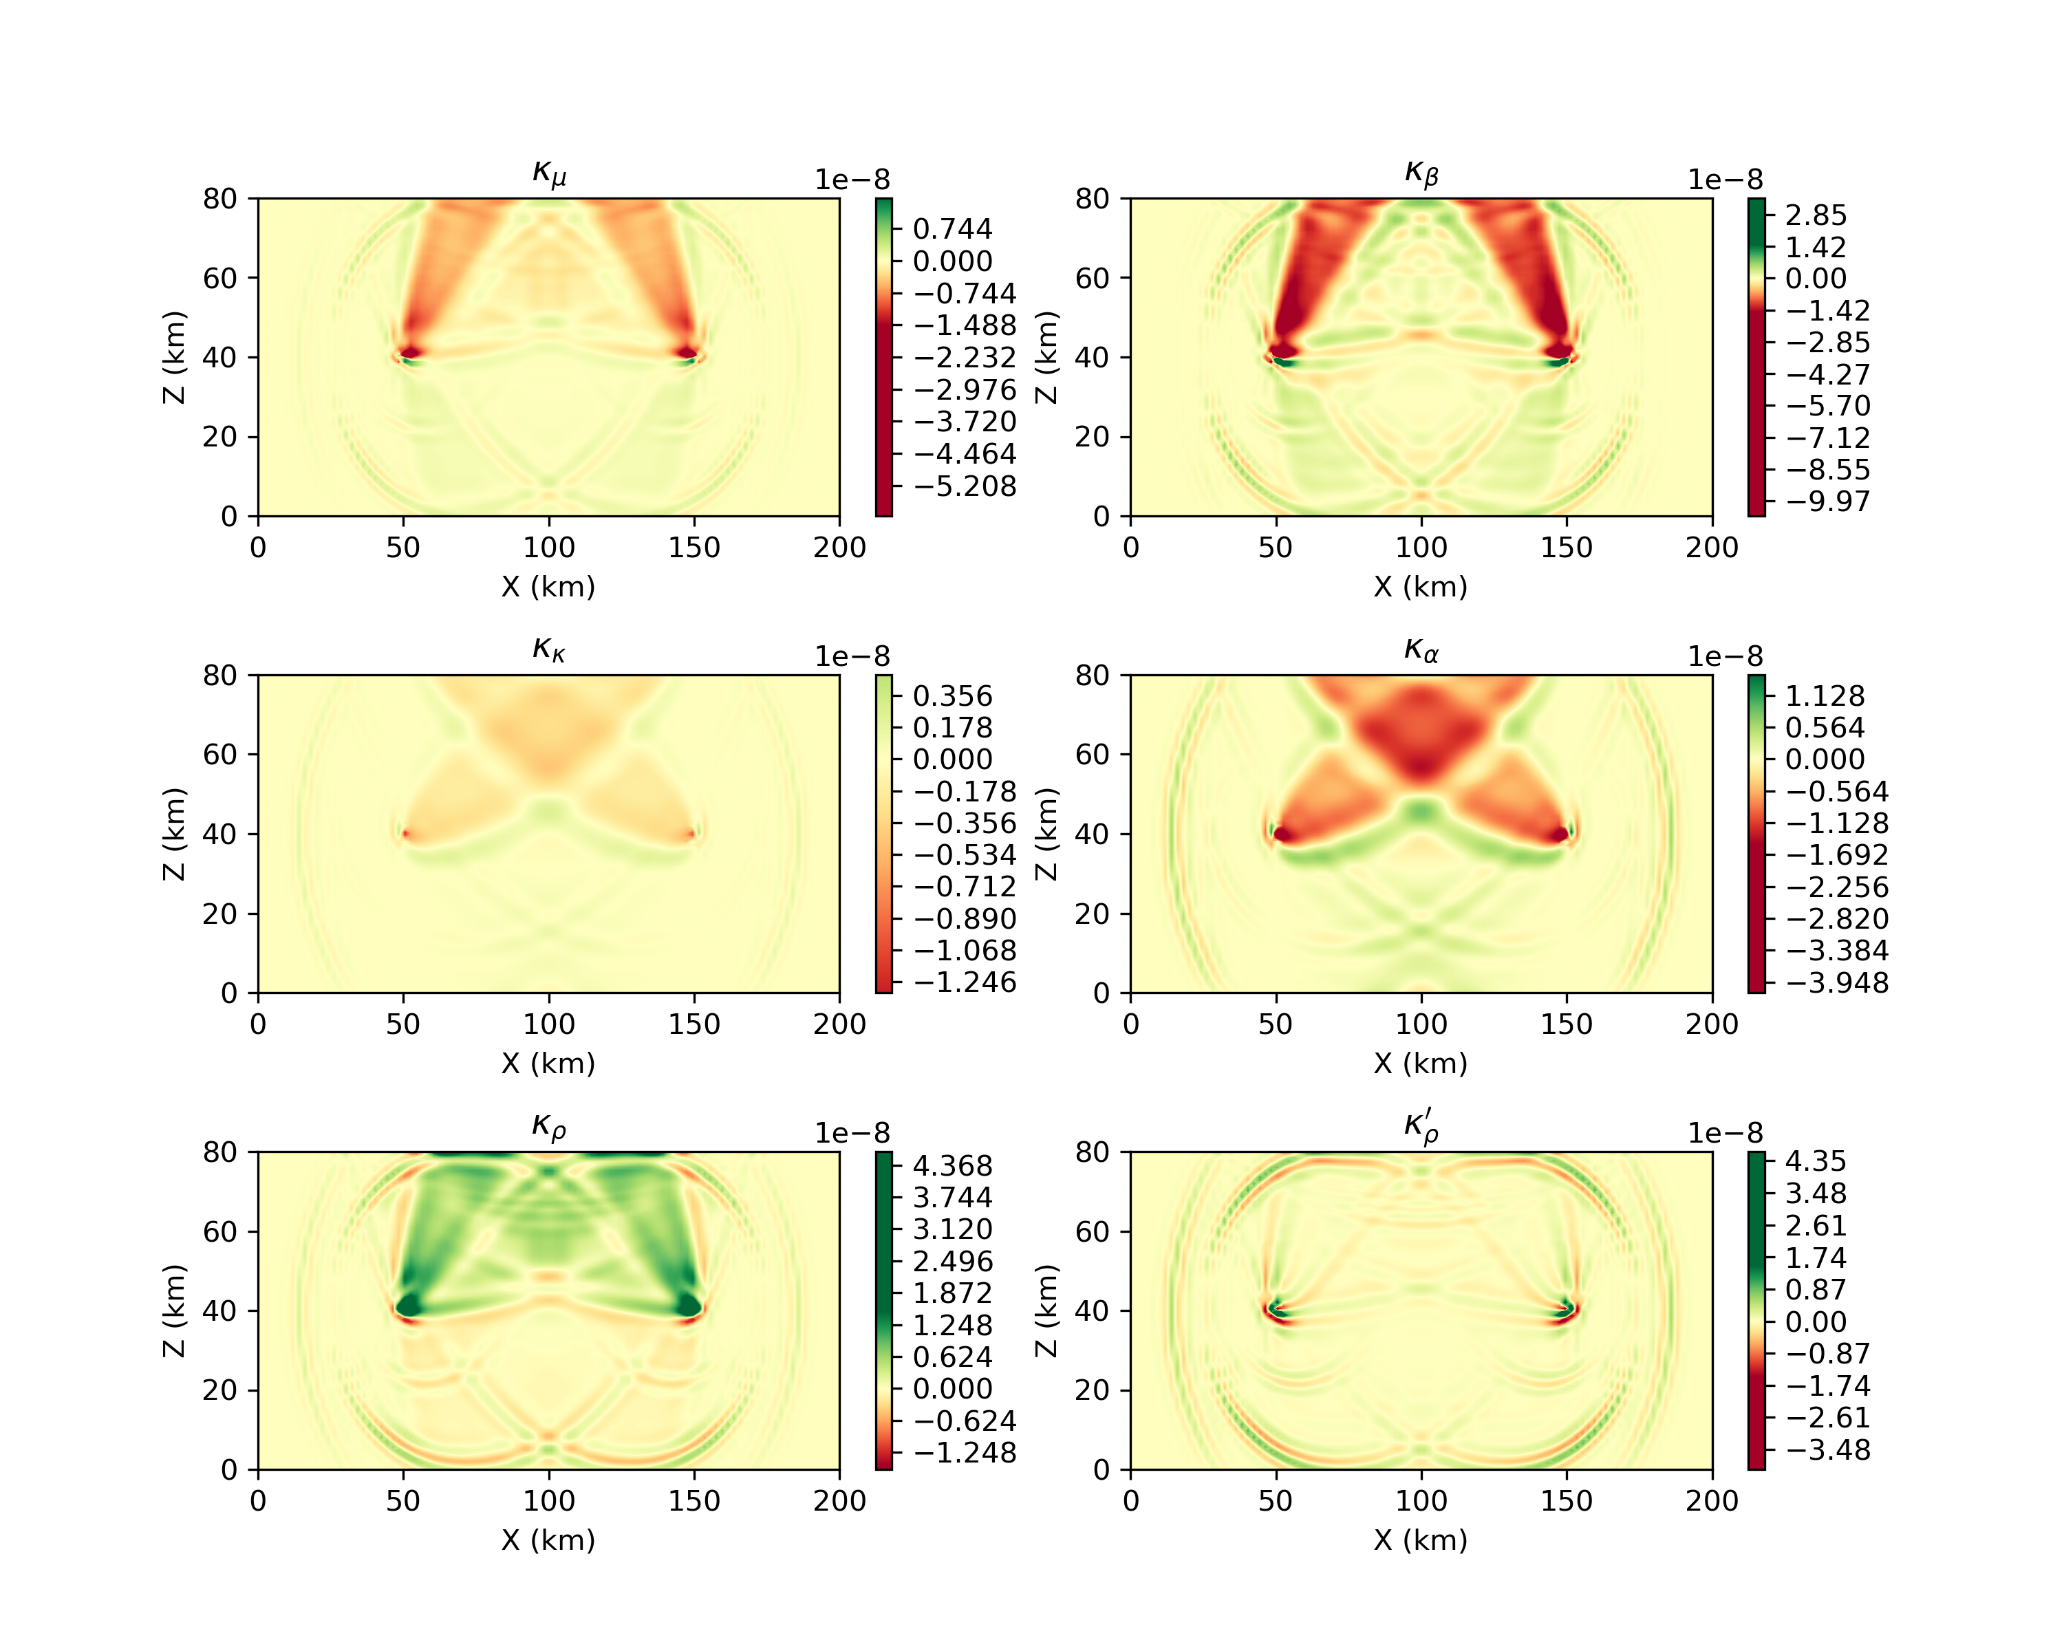
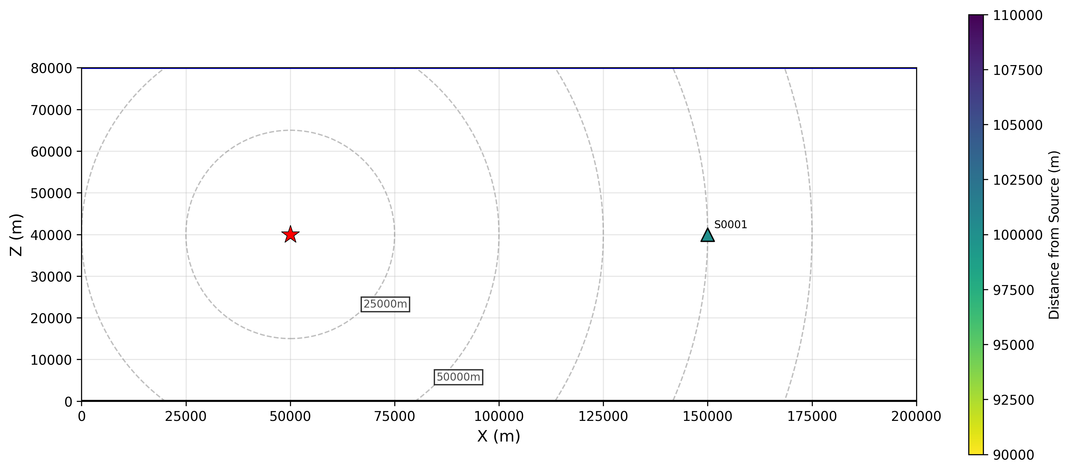
Kernels (Tromp et al. 2005)

Slide 5
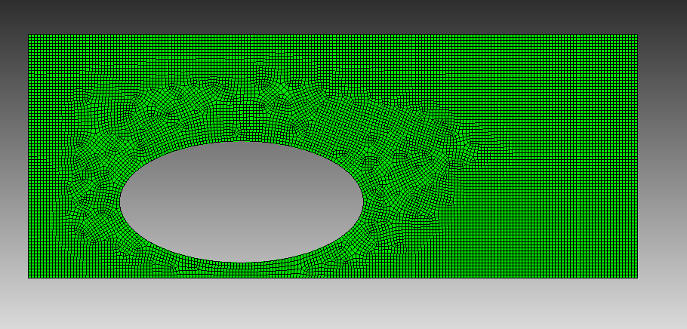

CUBIT

Slide 6
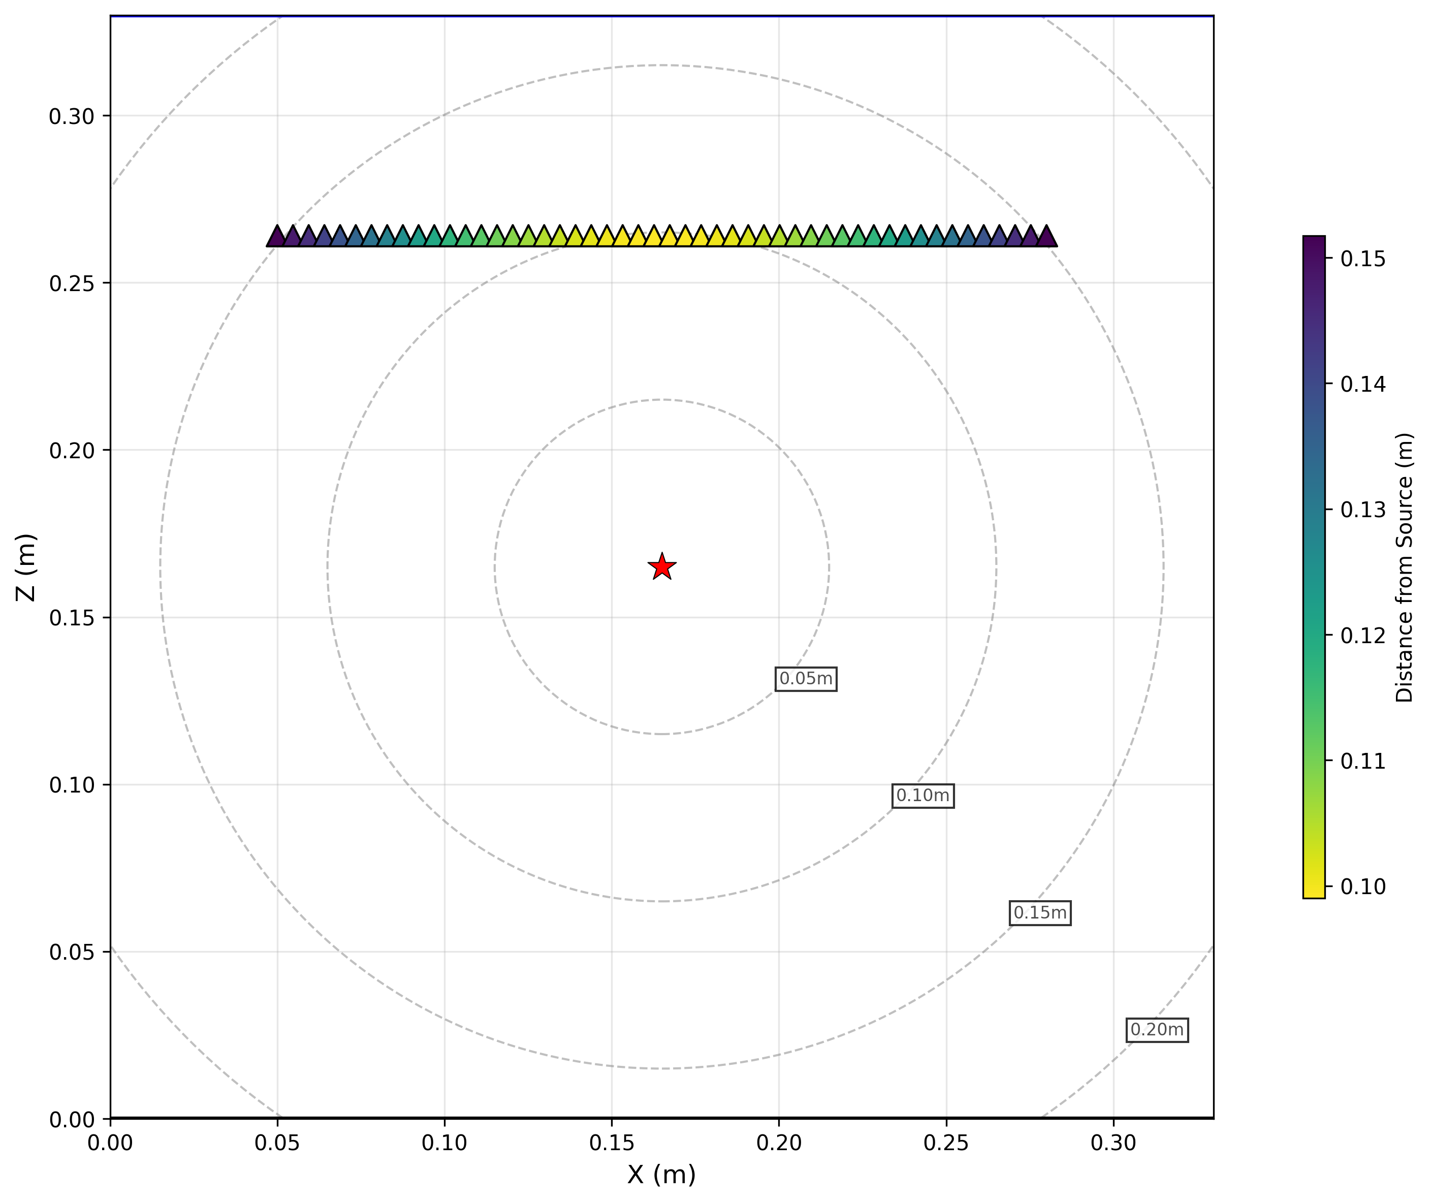

Translate: Anisotropic Crystal

